Slide 1
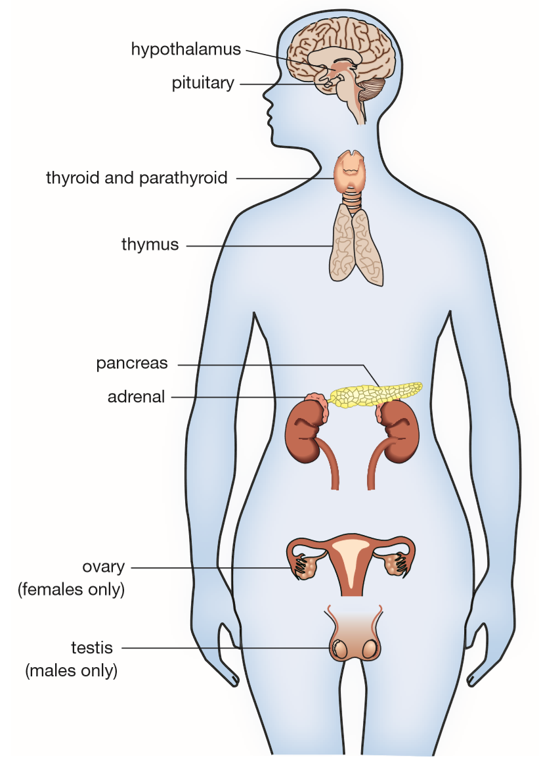
Daily Review
Due to homeostasis and negative feedback, blood glucose levels remain fairly constant at about 0.8–1mg/mL, irrespective of exercise and eating habits.
Homeostasis of blood glucose is due to the action of which two hormones produced by the pancreas?

Slide 2
Daily Review
Which hormone released from the pancreas increases blood glucose levels when the are low?
Describe the negative feedback for the action of glucagon on decreased blood glucose levels.
Decrease blood glucose
Pancreas secretes glucagon
Glucagon causes liver to release glucose
Increase in blood glucose level

Slide 3
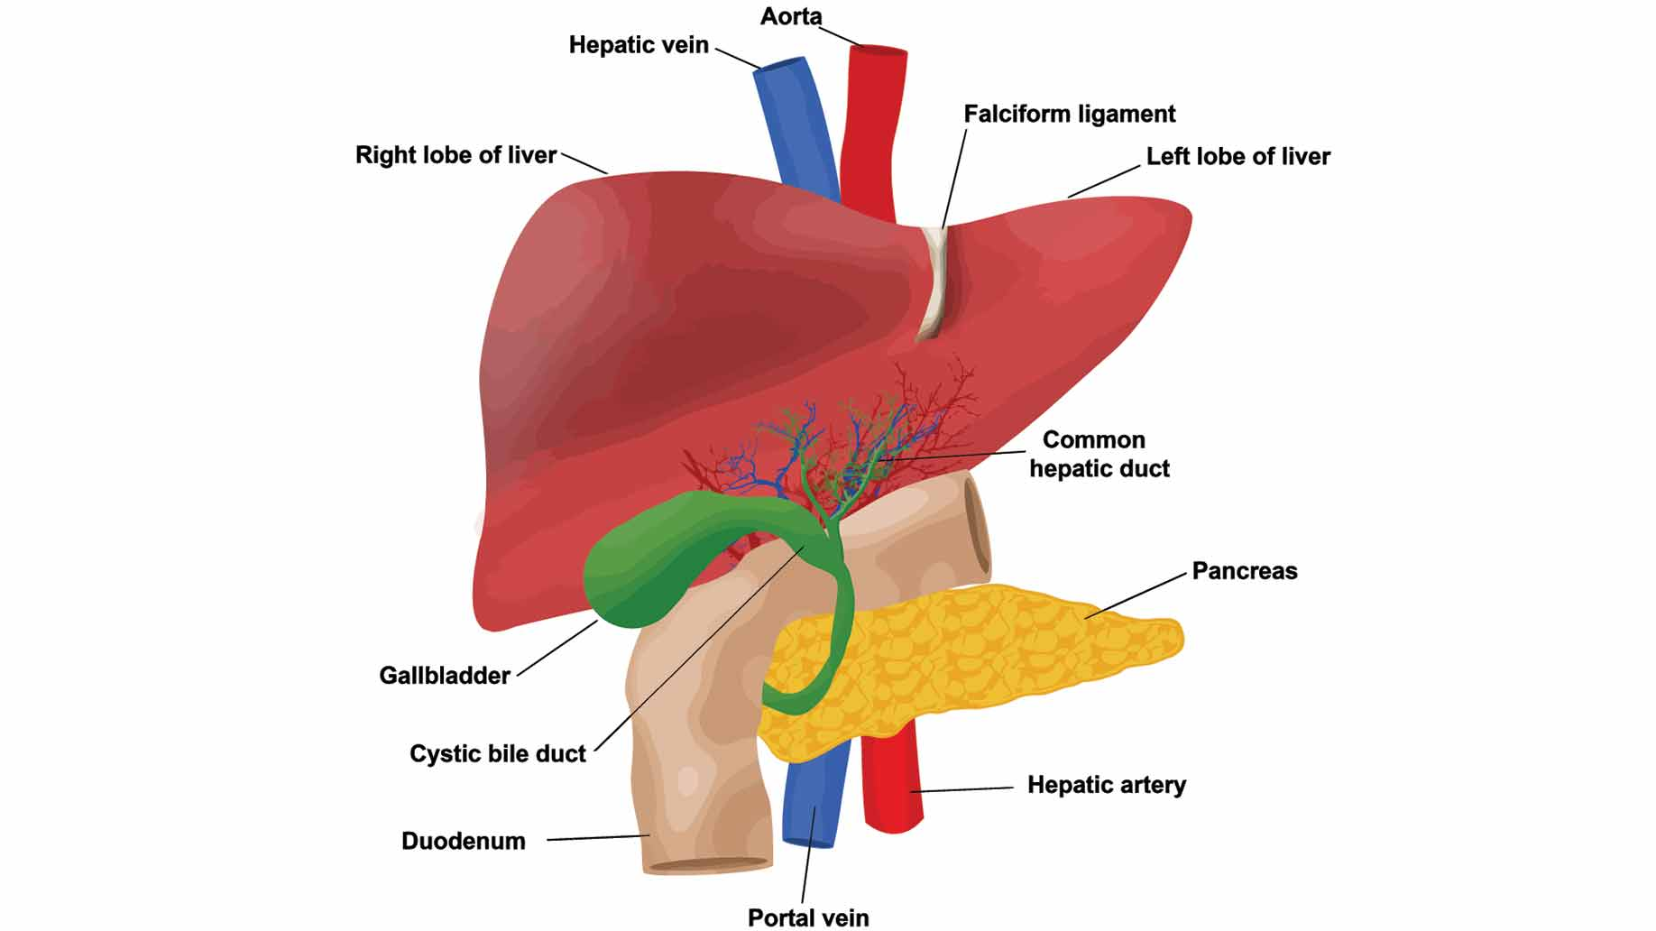
Daily Review
The pancreas releases insulin to lower blood levels, and glucagon to increase blood glucose levels. What role does the liver play in regulating blood glucose levels?

Slide 4
Pathogens & Disease
Year 9 Biology

Slide 5
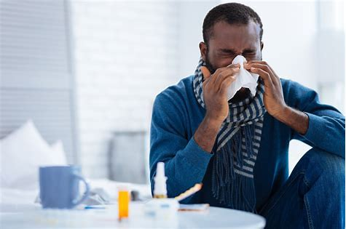
Learning Objectives
CFU
What are we going to learn?
Identify different pathogens that cause disease.
Explain how pathogens cause disease and can be prevented within the body.
Activate Prior Knowledge
Everyone becomes sick at one time or another. Some people even catch a cold a few times every year.
Think, Pair, Share:
What are some remedies for having a cold or flu?

Slide 6
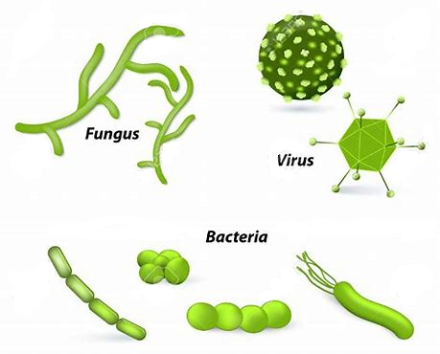
Concept Development
CFU 1
What is a disease?
CFU 2
What does a pathogen do?
Disease
A disease is anything that causes the body to stop working properly.
Pathogens are microorganisms which cause disease.
Pathogens include:
Bacteria
Fungi
Protozoa
Viruses
Parasites
Contagious diseases can easily be spread between people and within populations.
CFU 3
Think, Pair, Share: List three diseases. Do you know by what kind of pathogen they are caused?

Slide 7
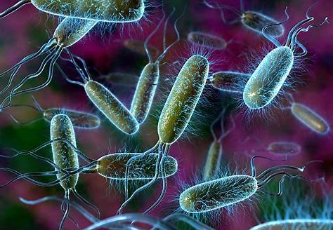
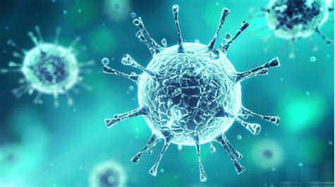
Concept Development
CFU 1
How do bacteria affect the body?
Bacteria and Viruses
Bacteria are very small cells that are able to reproduce by themselves.
They release toxins that affect the normal functioning of the body.
Only a small percentage of known bacteria cause are pathogens.
Viruses are unable to reproduce by themselves.
They invade our body’s cells and use the organelles to make new copies of the virus.
This stops the body cells from functioning properly.
CFU 2
What is the difference between a bacterium and a virus?

Slide 8
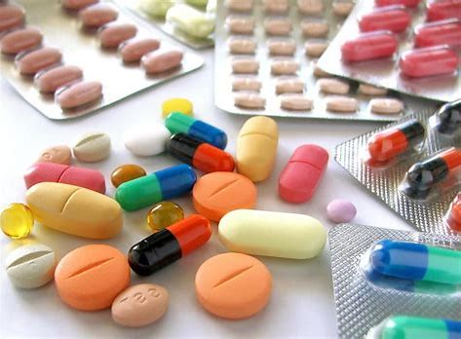
Concept Development
CFU 1
Why are humans not affected by antibiotics?
Antibiotics
Antibiotics release chemicals that destroy bacteria.
Penicillin is a common antibiotic which breaks down the cell wall of bacteria.
Humans do not have cell walls, so are unaffected by antibiotics.
Viruses are not affected by antibiotics as they are coated with a special protein which protects them.
Because of this, most viruses cannot be treated with medicine; only their symptoms can.
CFU 2
Do antibiotics destroy viruses? Why/why not?

Slide 9
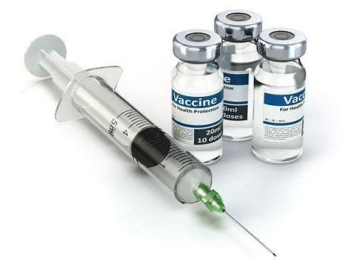
Concept Development
CFU 1
What is a vaccine?
Vaccines
Vaccines are chemicals that cause the body to respond as if it had a pathogen, when it does not.
A vaccine is created by taking a small amount of the inactive virus or poison produced by the bacterium.
The inactive virus and bacteria are harmless, but our immune system responds to the vaccine by making antibodies and we become immune to the pathogen.
If the pathogen enters the body in the future, the immune system can respond much quicker and prevent the disease.
CFU 2
How do vaccines protect us from disease?

Slide 10
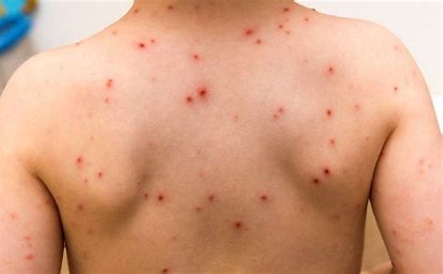
Skill Development/Guided Practice
Reminder
A vaccine is created by taking a small amount of the inactive virus or poison produced by the bacterium.
CFU 1
Can this disease be treated with antibiotics? Why/why not?
Chicken pox is a disease that is caused by the viral pathogen varicella. Its symptoms include an itchy rash with small blisters.
How could this disease be treated?
CFU 2
Can this disease be prevented with a vaccine?
Chicken pox cannot be treated with antibiotics because it is a virus, not bacteria.
Only the symptoms of an itchy rash and blister can be treated.
Chicken pox could be prevented with a vaccination as the pathogen is a virus.

Slide 11
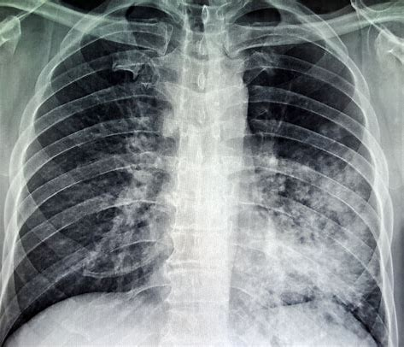
Skill Development/Guided Practice
CFU 1
Can this disease be treated with antibiotics? Why/why not?
Tuberculosis is a disease caused by the bacteria mycobacterium tuberculosis. Its symptoms include a cough with mucus, fever, weakness, and shortness of breath.
CFU 2
Can this disease be prevented with a vaccine?
Tuberculosis can be treated with antibiotics because it is caused by bacteria.
Tuberculosis could be prevented with a vaccination as the pathogen is a bacterium.

Slide 12
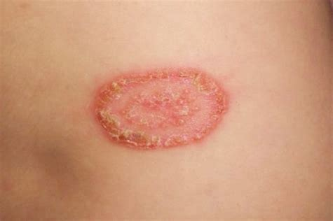
Skill Development/Guided Practice
CFU 1
Can this disease be treated with antibiotics? Why/why not?
Ringworm is a disease caused by a fungal infection. Its symptoms include red, itchy patches on the skin that develop blisters.
CFU 2
Can this disease be prevented?
Ringworm cannot be treated with antibiotics because it is caused by a fungus, not bacteria.
Ringworm cannot be prevented with a vaccine as it not a bacterium or virus.

Slide 13
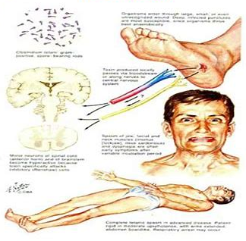
Skill Development/Guided Practice
CFU 1
Can this disease be treated with antibiotics? Why/why not?
Tetanus is a disease caused by the bacteria clostridium tetani. Its symptoms include painful muscle contractions, particularly of the jaw and neck muscles. .
CFU 2
Can this disease be prevented with a vaccine?
Tetanus can be treated with antibiotics because it is caused by bacteria.
Tetanus could be prevented with a vaccination as the pathogen is a bacterium.

Slide 14
Relevance
Our bodies are complex organisms that are constantly responding to changes in the external and internal environment.
Knowing about pathogens that cause disease in the body can help to prevent infections not only in our own body, but within the community as well.

Slide 15
Skill Closure
Describe what a pathogen is. What are some different types of pathogen?
Skill Closure
Explain how vaccines help prevent disease.
Skill Closure
What is the difference between antibiotics and vaccines?

Slide 16
Independent Practice
Complete the Disease Table, using your device to research.
Marigold
Rafflesia
Trumpet Vine
Cactus

